Slide 1
CryptoCard
Arda ÖĞÜN
Göksu KAYA
Göktuğ YEŞİLYURT

Slide 2


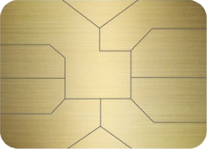
CryptoCard
Erkan UÇAR
1111 2222 3333 4444
Make Crypto
Great Again!
❌No Exchanges
C
✅ Quick and Convenient
❌No Long Delays
✅ Seamless Payments

Slide 3
ESS
MIS DSS
TPS

Slide 4
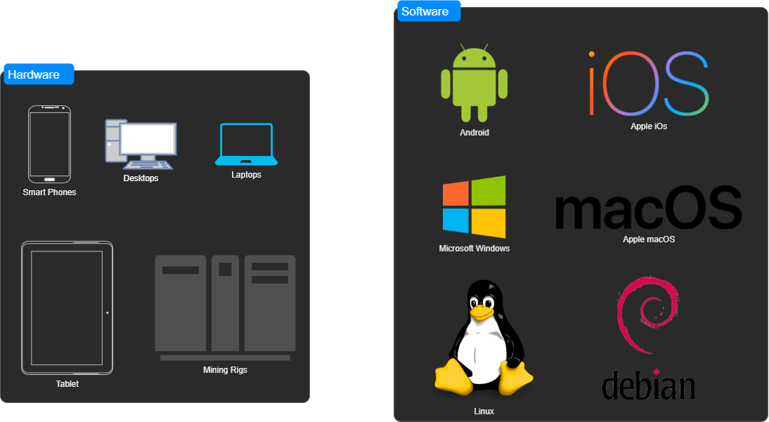

Slide 5
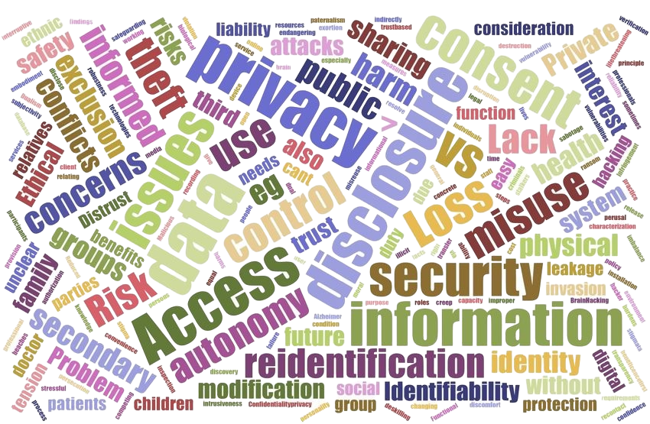
Possible wallet address violation
Volatile value
Fake transactions

Slide 6
Thanks for listening!

